Slide 1
Ministry category : Hughes Systique Pvt Ltd Problem Statement : Secure distributed transaction recording system College Code : 802 Team Leader Name : Amit Sahu Problem Code: SS1
Idea: Design a system by which we can record and make visible/non-falsifiable/non-repudiable the different transactions between a common citizen and a govt. department for getting and managing a particular form of license/permit. For a specific example, we consider the driving permit. The system should be able to track the different transactions starting from getting the permit (retail/commercial), renewal, recording of traffic rule violations, and possibly, revocation/suspension.
Solution: For this purpose we develop a web app where we provide login to our three main users –Traffic Police Officer, People and Administrator of app. Traffic police will login by People’s Driving License and Finger print(Thumb). Then a dashboard will be open with basic details of DL holder and next section containing a form with fields such as, Offences and their corresponding fines and sections as declared by Government of India. Officers have to select one of them from drop down menu list. Further more fields will contain fine receipt number, vehicle detail, place of offence, etc. Another fields will be there to take officer details such as his/her unique identification number, name etc. to provide authenticity and transparency. This will be a short form which require very less time to fill in and submit. There will be another tab by which traffic police officer can also see more details of DL holder.
Another section will provide login to people by their DL number and Date of Birth, then a dashboard will be appear with all details of user where he/she can see all transactions on their DL.

Slide 2
Further DL holder can provide feedback about this service and app, and can also file a online complain against traffic police officer or any problem they faced during this process.
Another section is provided to Administrator of this service who will login with a specific username and password and can reply to feedbacks and complains and inform people on their queries. Anyone can see all feedbacks and complain by guest login they can’t do manipulation in feedbacks and complains. A FAQs section is also provided in this page.
Technology Stack:
front end will be developed using HTML/CSS/JavaScript and JavaScript’s Frameworks
Backend will be developed through Node.js with Express Framework and MongoDB database
Dependencies/Showstoppers:
1) We need Government’s Driving License's databases which contain all the details of driving license permitted by government.
2) Biometric sensor/Finger print sensor for login process by traffic police officers.

Slide 3
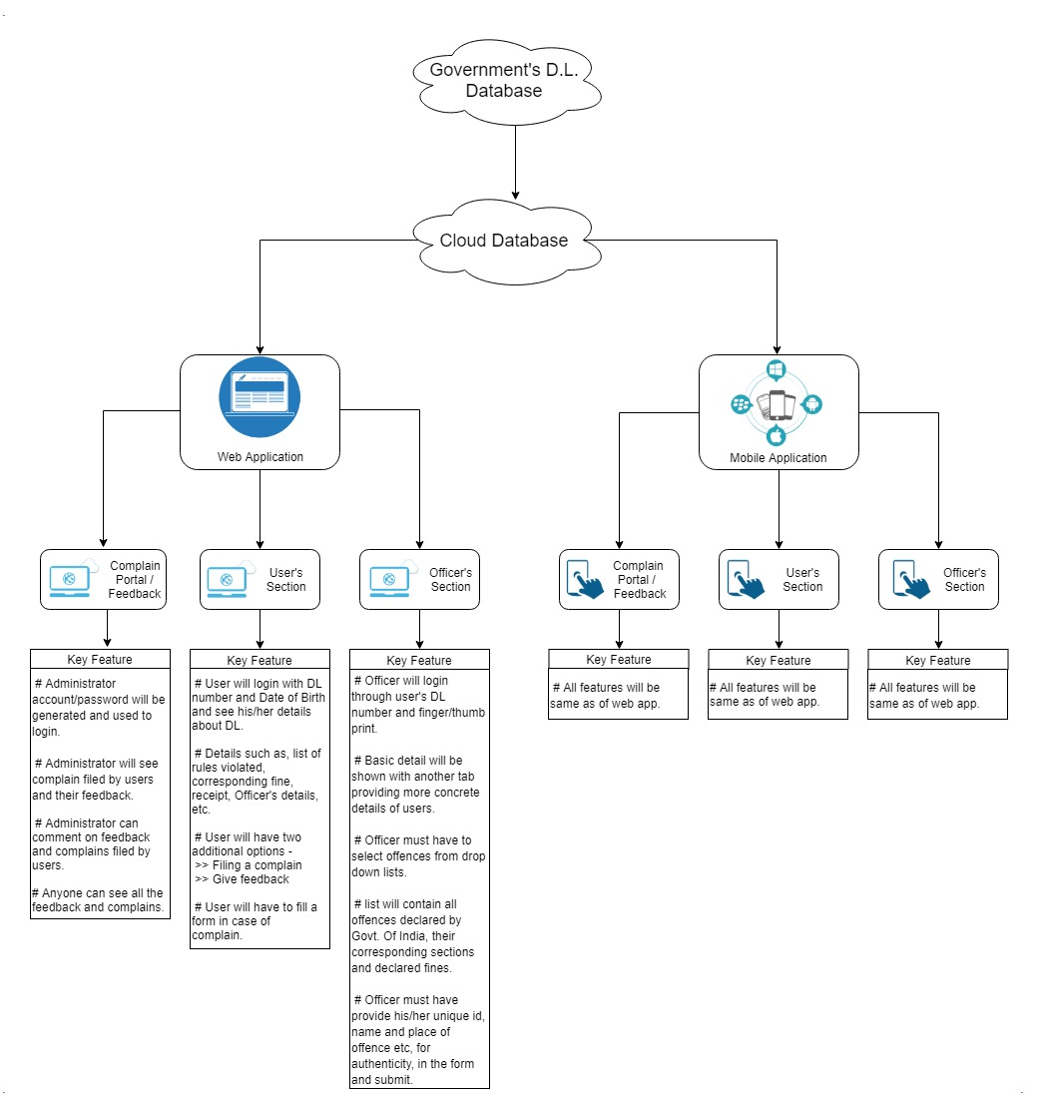
UML Case Diagram

Slide 4
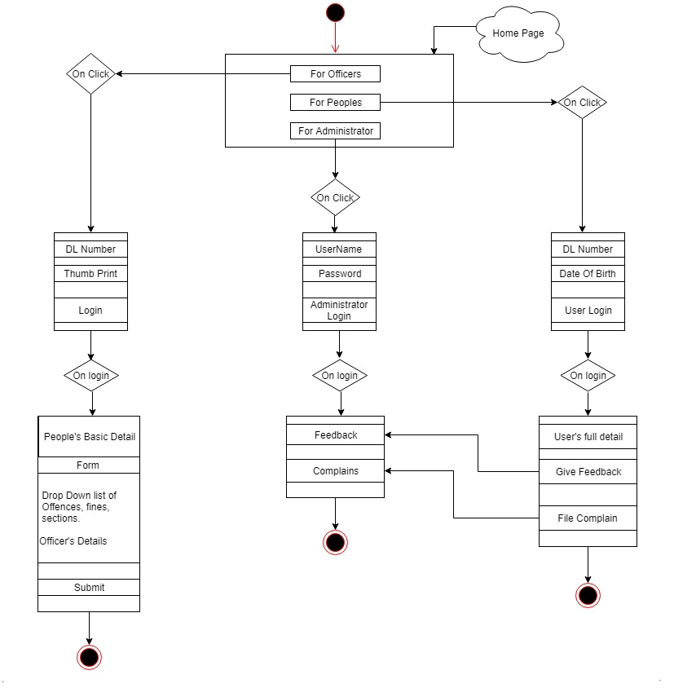
Web-App Flow Diagram

